Slide 1


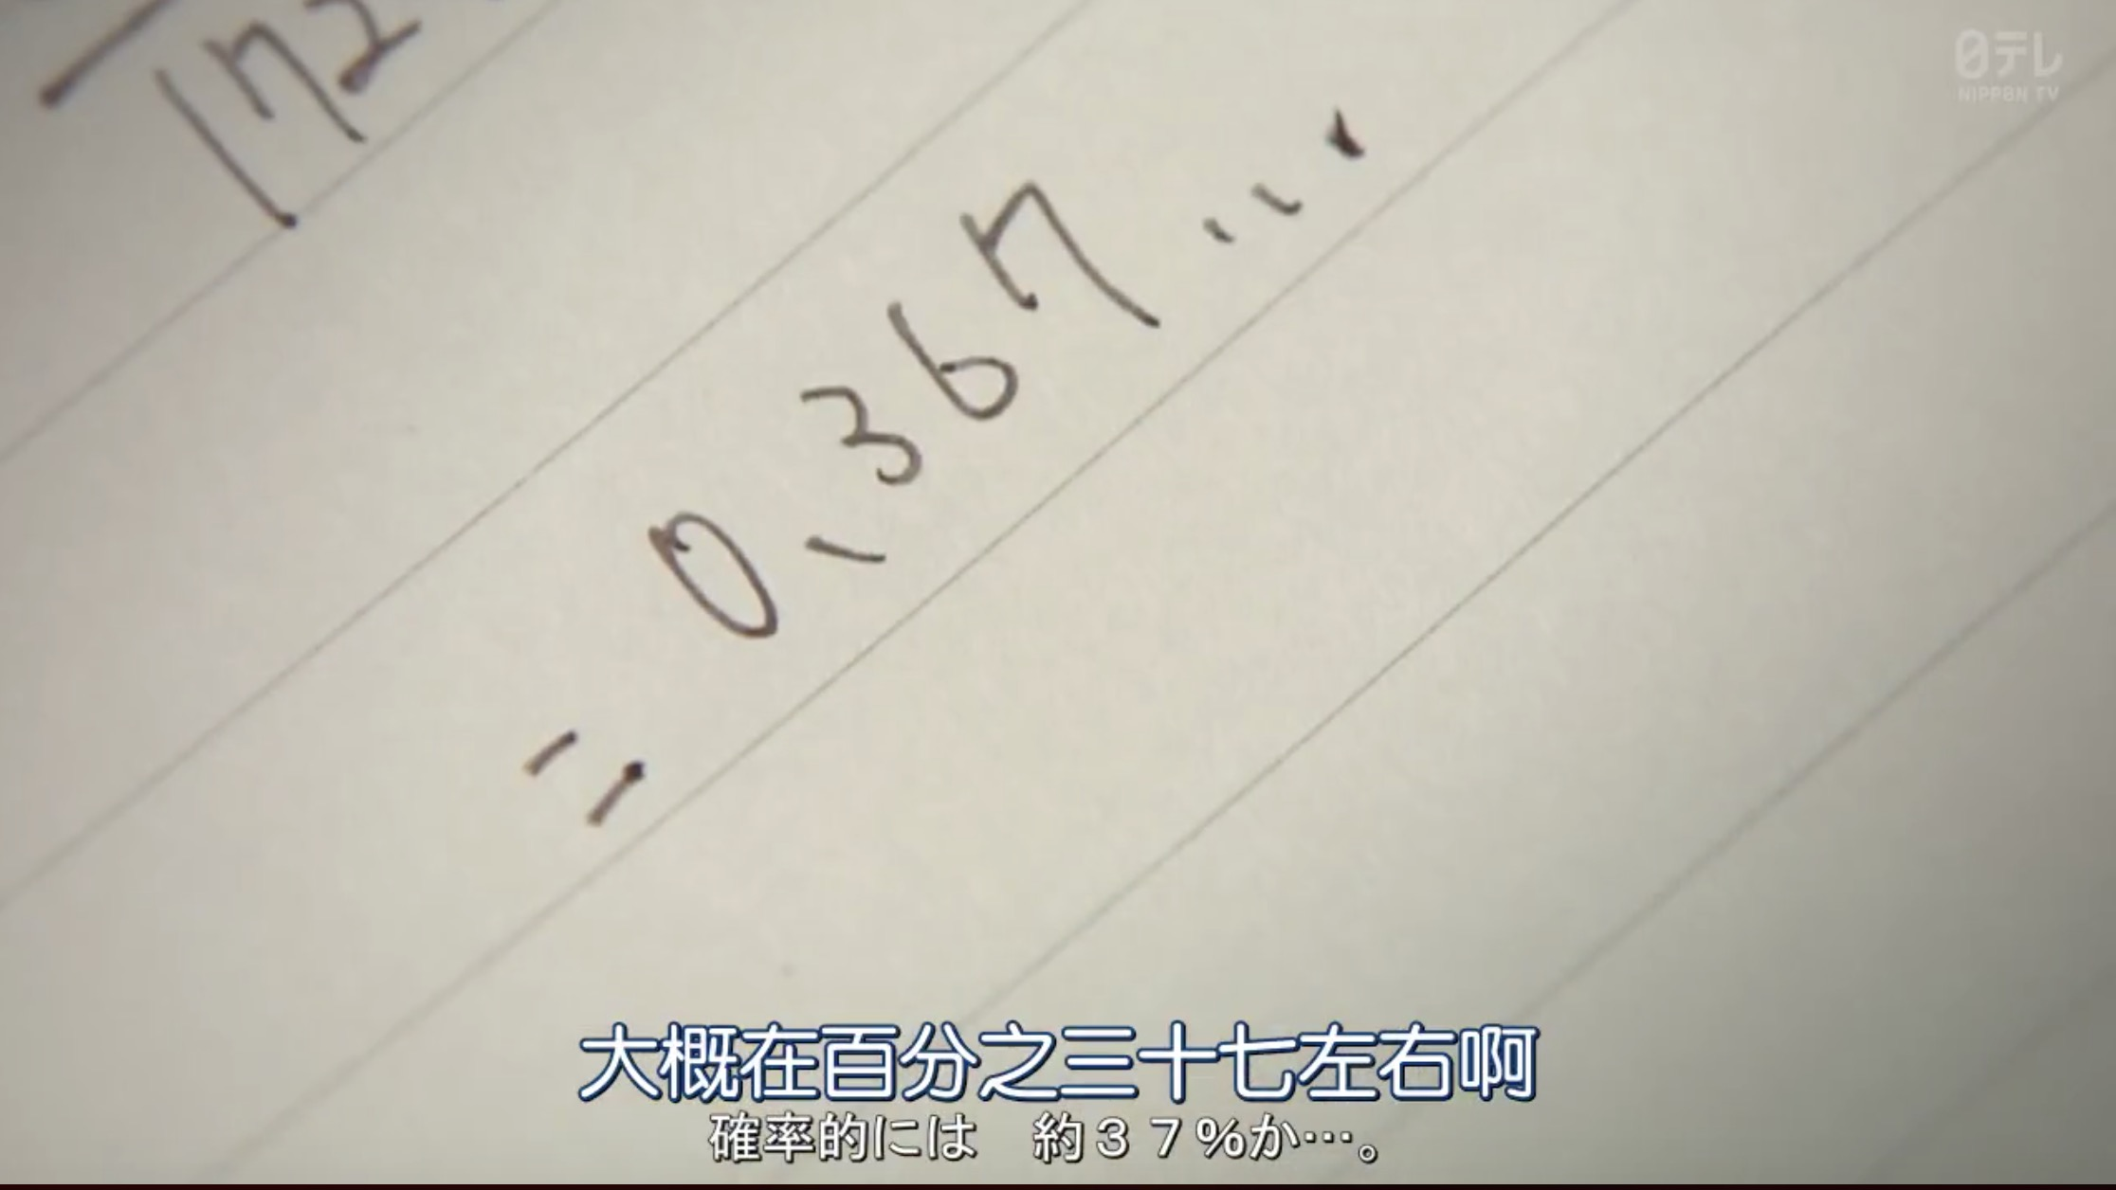

Slide 2
Derangement & Hamiltonian Cycle

Slide 3
Derangement
Definition: a derangement is a permutation of the elements of a set, such that no element appears in its original position.
Counting derangements:
When n = 1, 1! = 1, #derangements = D₁ = 0.
When n = 2, 2! = 2, D₂ = 1.
When n = 3, 3! = 6, D₃ = 2. ( 3 1 2; 2 3 1)
D₄ = 9, D₅ = 44, D₆ = 265, D₇ = 1854.
When n is large…

Slide 4
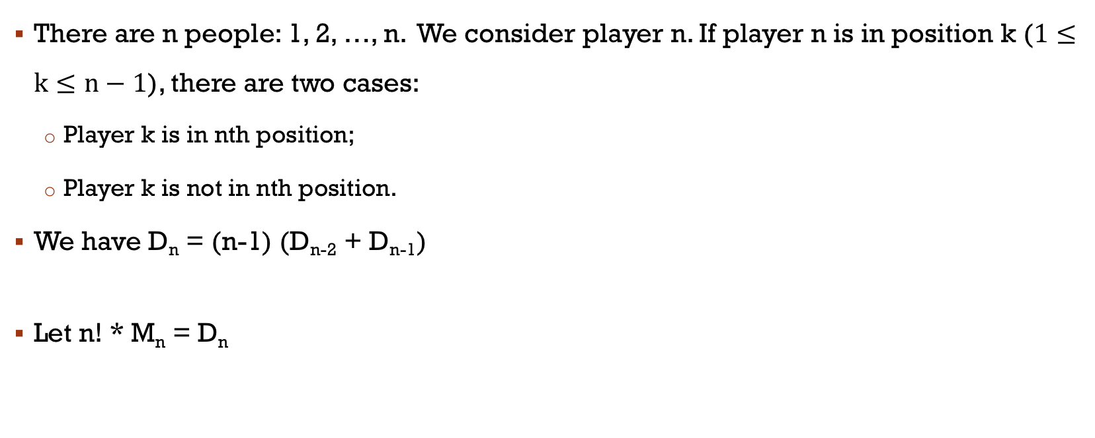
There are n people: 1, 2, …, n. We consider player n. If player n is in position k ($1≤k≤n−1$), there are two cases:
Player k is in nth position;
Player k is not in nth position.
We have D_{n} = (n-1) (D_{n-2} + D_{n-1})
Let n! * M_{n} = D_{n}

Slide 5
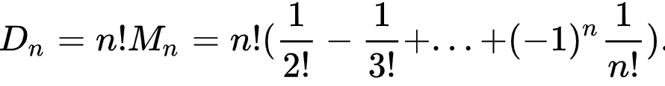
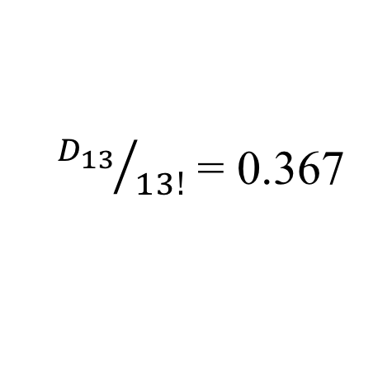
D_{n} = (n-1) (D_{n-2} + D_{n-1})， n! * M_{n} = D_{n}
${D_{13}}/{13!}$ = 0.367

Slide 6
M₁ = 0
M₂ = 0.5
M₃ = 0.3333
M₄ = 0.375
M₅ = 0.3667
M₆ = 0.3680
M₇ = 0.3678
M₈ = 0.3679
M₉ = 0.3679
M₁₀ = 0.3679

Slide 7
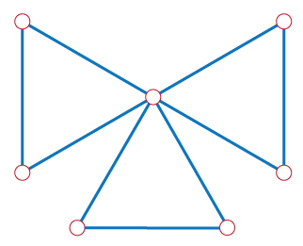
Hamiltonian Cycle Problem
Given a graph G, is there a cycle that visits every vertex exactly once? Such a cycle is called a Hamiltonian Cycle.
No Hamiltonian cycle
Has a Hamiltonian cycle

Slide 8
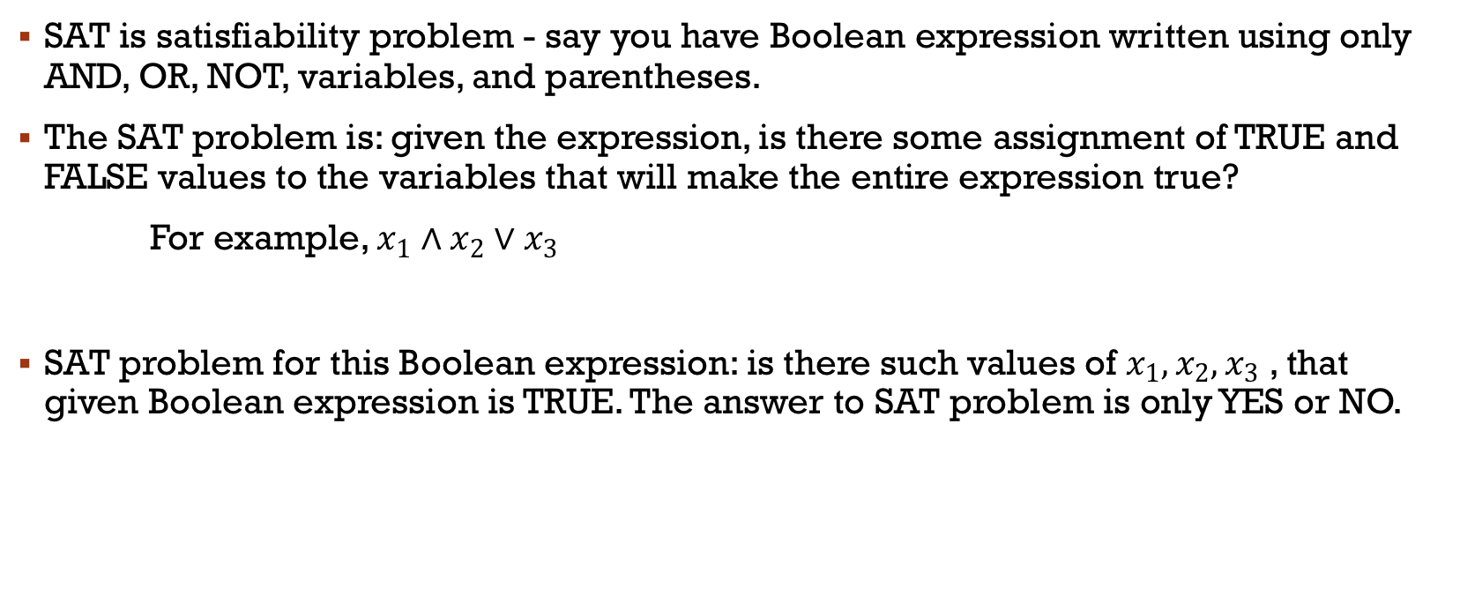
SAT Problem
SAT is satisfiability problem - say you have Boolean expression written using only AND, OR, NOT, variables, and parentheses.
The SAT problem is: given the expression, is there some assignment of TRUE and FALSE values to the variables that will make the entire expression true?
For example, $x_{1}∧x_{2}∨x_{3}$
SAT problem for this Boolean expression: is there such values of $x_{1},x_{2},x_{3}$ , that given Boolean expression is TRUE. The answer to SAT problem is only YES or NO.

Slide 9

3-SAT Problem
3-SAT problem is a special case of SAT problem, where Boolean expression should have very strict form.
$ϕ=C_{1} ∧ C_{2} ∧ C_{3} ∧… ∧C_{k}$
$C_{i}= a_{i} ∨ b_{i} ∨ c_{i}$
$a_{i},b_{i}, c_{i} ∈\{x_{l},\text{¬}(x_{l})\}$

Slide 10
Hamiltonian Cycle Problem is NP-complete
We already knew that 3-SAT problem is NP-complete.
First, Hamiltonian cycle is in NP class. If such a cycle is discovered somehow (maybe with exponential time brute force searching), we could easily work it out whether the path is HAMCYCLE or not, in polynomial time.
Second, we show that 3-SAT ≤_{P} Hamiltonian Cycle.
Suppose we have a black box to solve Hamiltonian Cycle, how do we solve 3-SAT?

Slide 11
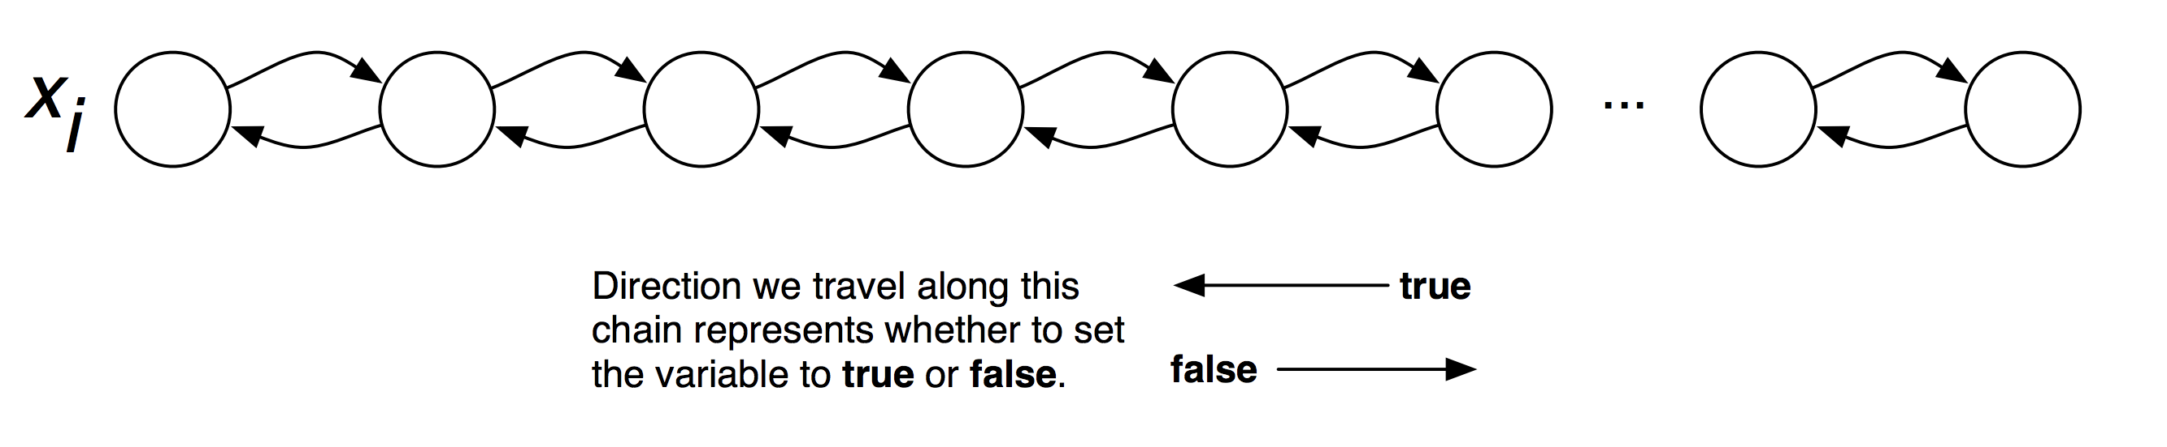
Gadget Representing the Variables

Slide 12
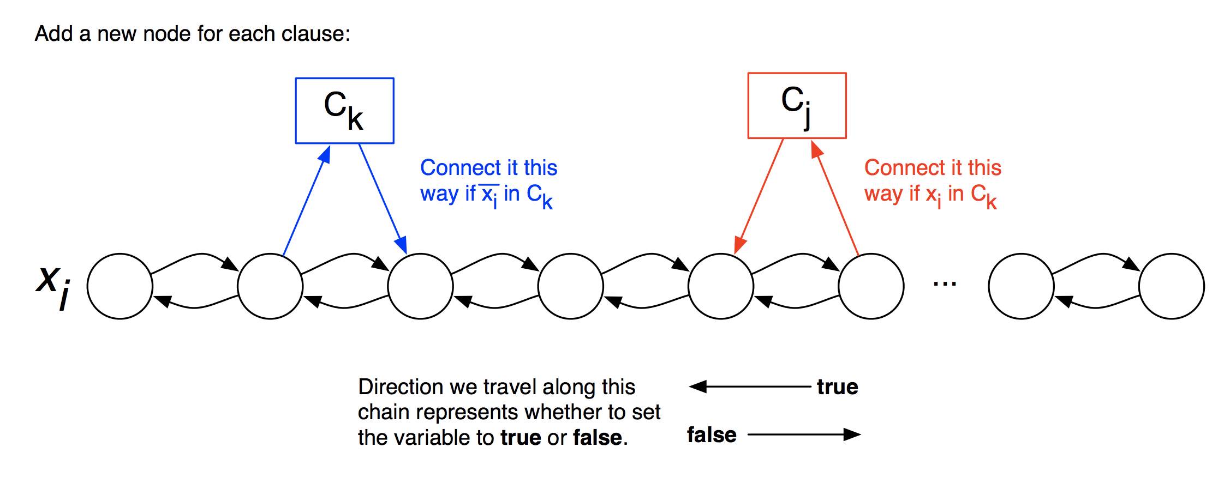
Honking in the Clauses

Slide 13
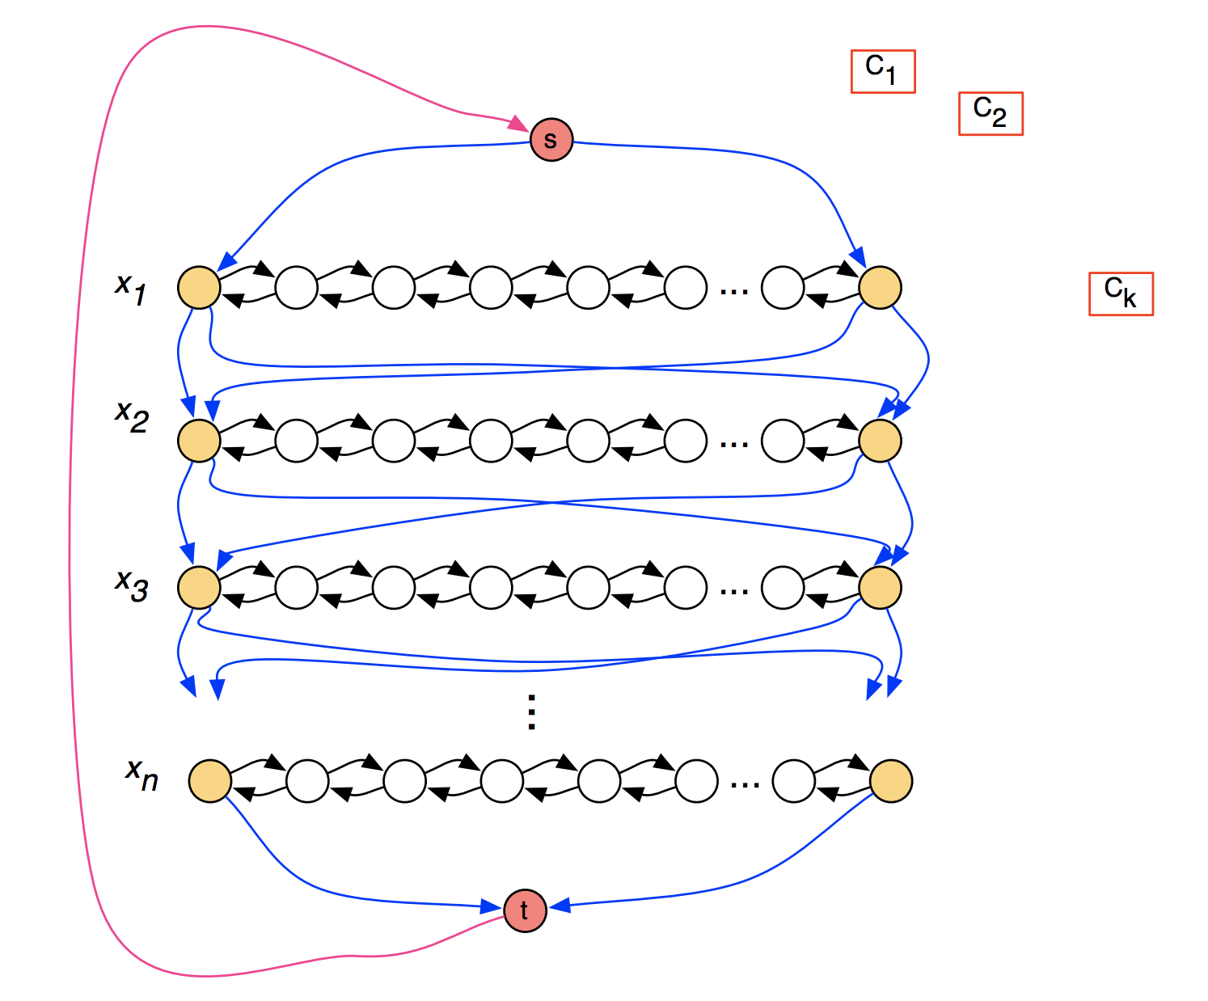
Connecting up the Paths

Slide 14
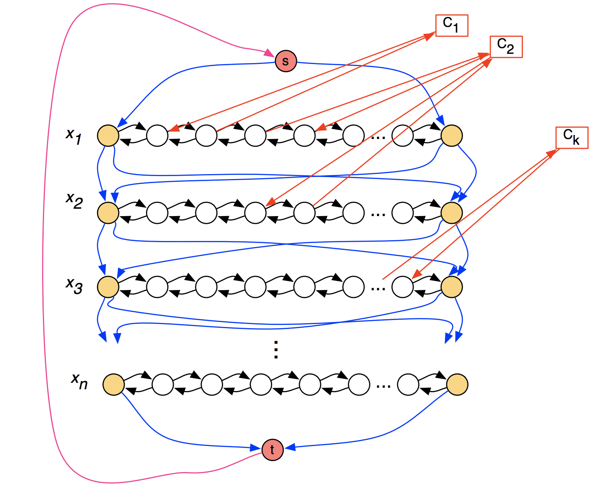
Connecting up the Paths
For there to be a Hamiltonian cycle, we have to visit every clause node.
We can only visit a clause if we satisfy it (by setting one of its terms to true).
Hence, if there is a Hamiltonian cycle, there is a satisfying assignment.

Slide 15
Thank You

